Slide 1

Phase 1 Project A Microsoft Movie analysis
By Maureen Anduuru

Slide 2
bACKGROUND
Microsoft want to know if its viable to enter in to the movies industry and if they invest in it will get back there return on investment and what movies to produce. The main objective of the project is to give unbiased findings and the action to take.

Slide 3
BUSINESS UNDERSTANDING
Microsoft wants to know which movies to produce that will give them high yields, and keep then on top of the list by providing the most popular movies.
To be able to get to meet there expectations we need to find the Return on investment (ROI) for several genres across the years, we would need to gather data on box office revenues and production budgets for movies in each genre, as well as other relevant data such as marketing costs and distribution expenses.
We could then calculate the ROI for each movie by subtracting the production budget and other costs from the box office revenue, and dividing the result by the production budget. By aggregating these ROI values for each genre across the years, we could then identify which genres have historically provided the highest ROI and which have underperformed. Knowing these it will enable the management make informed decision on what to invest in.

Slide 4
SUPPORTING DATA
The data was provided by Microsoft and sourced from various websites on the internet. They came in different formats some were CSV files and others were Tsv files. They are as follows
Box Office Mojo
IMDB
Rotten Tomatoes
TheMovieDB

Slide 5
DATA ANALYSIS
Various data sets were used to deduce the most appropriate course of action for Microsoft.

Slide 6
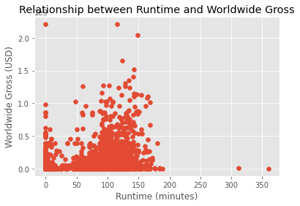
This means we recommend movies to be no longer than 180 minutes

Slide 7
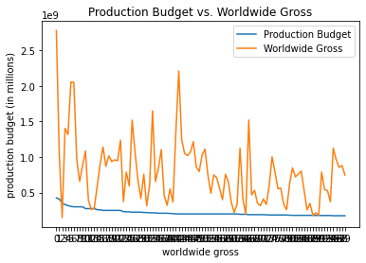
This means we recommend investment into movie production so as to get a corresponding increase in worldwide Gross revenue.

Slide 8
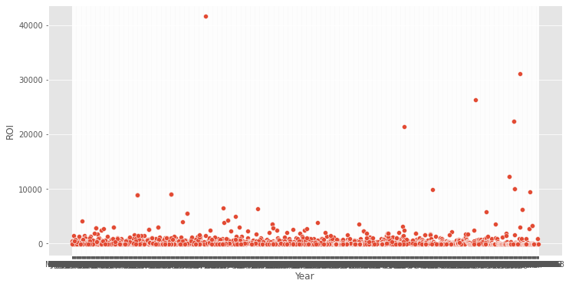
Graph showing Return On Investment against The year
The return on investment across the years is not dependent on the specific genre.

Slide 9
Recommendations
According to my findings its very viable for Microsoft to enter into the movie industry and they should invest more on marketing so as to become more popular which leads to increased sales hence more return on investment.
This recommendation is based on the high worldwide gross sales of movies in these genres as evidenced by our analysis.
Overall, this dataset provides valuable information for anyone interested in the movie industry or data analysis.

Slide 10
THANK YOU
By: Maureen Anduuru Maureen.anduuru@student.moringaschool.com https://www.linkedin.com/in/maureen-saitia/

